Slide 1
Data Visualization of Tips Dataset
- Using Matplotlib and Seaborn Library

Slide 2
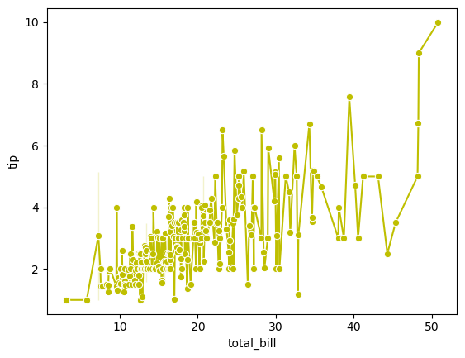
Customer who gives maximum bill also give maximum tip.

Slide 3
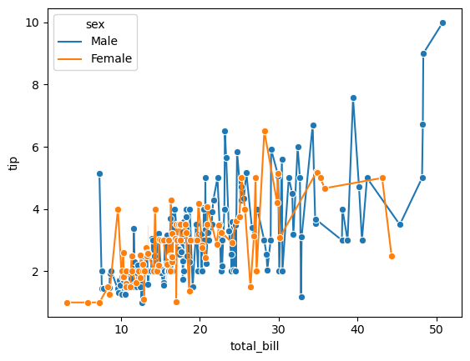
Males Give maximum bill and Females give minimum bill and tip.

Slide 4
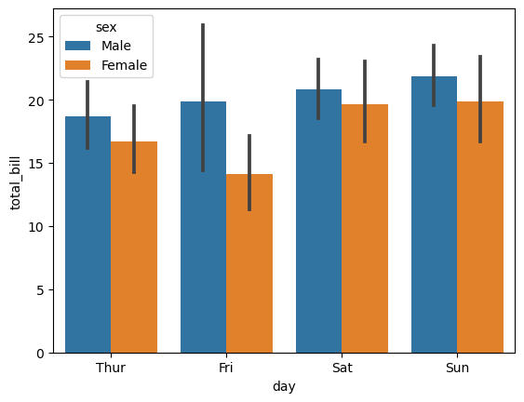
Maximum bill pay on Sunday and pay by males.

Slide 5
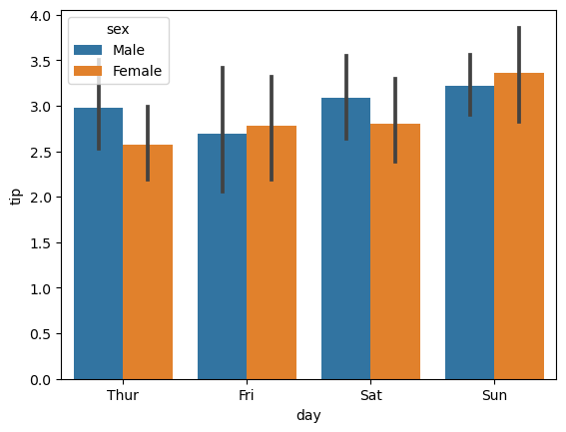
Maximum tip give on Sunday by Females.

Slide 6
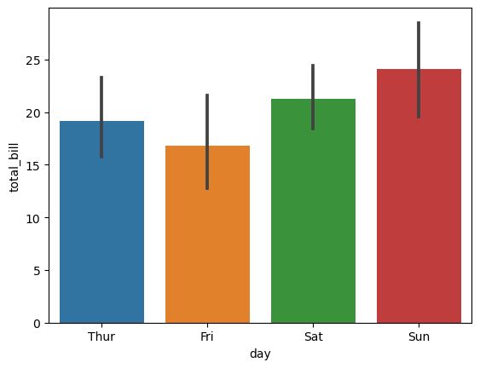
Maximum Smokers Pay bill on Sunday.

Slide 7
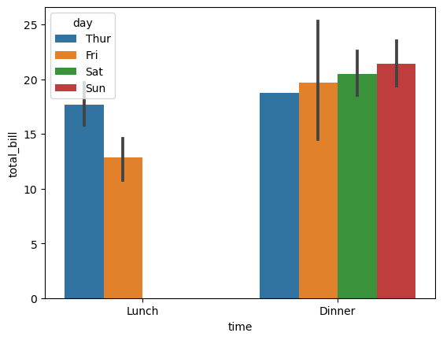
People go for lunch only Thur and Fri.

Slide 8
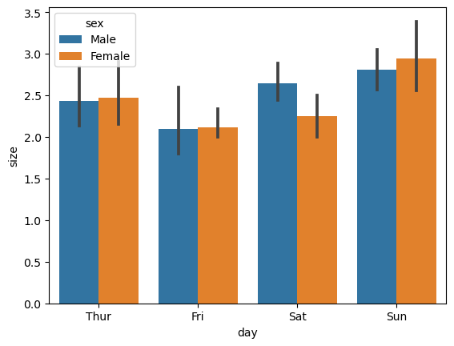
Maximum size of Customers on Sunday and Minimum Size on Fri.

Slide 9
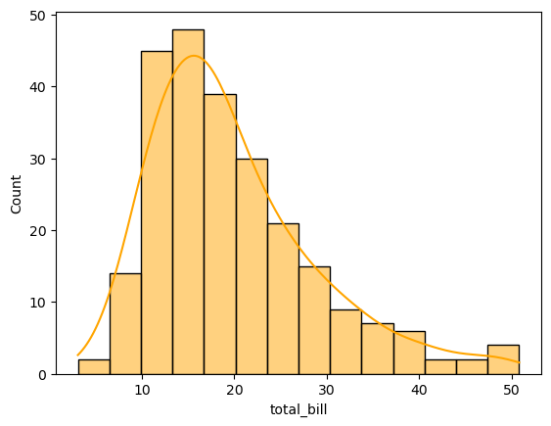
Most of the People Pay Bill between 15 to 20.

Slide 10
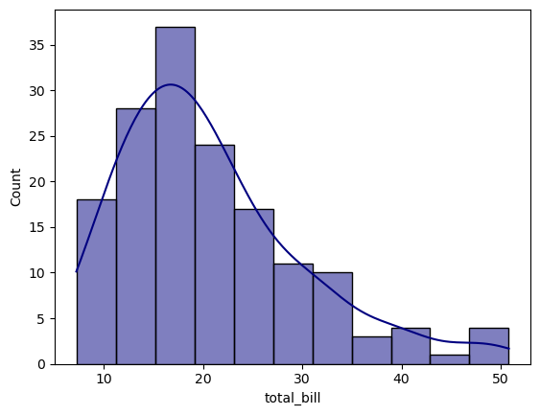
Most of the Males pay bill between 15 to 20

Slide 11
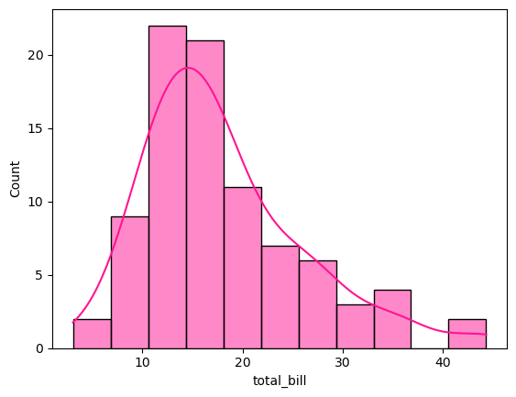
Most of the Females pay bill between 10 to 20.

Slide 12
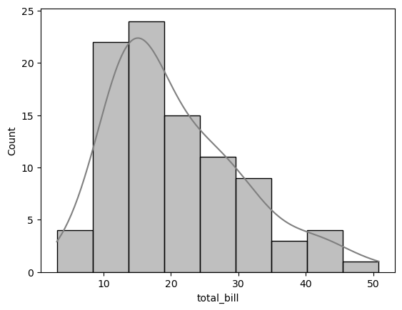
Most of the smokers pay bill approx 15.

Slide 13
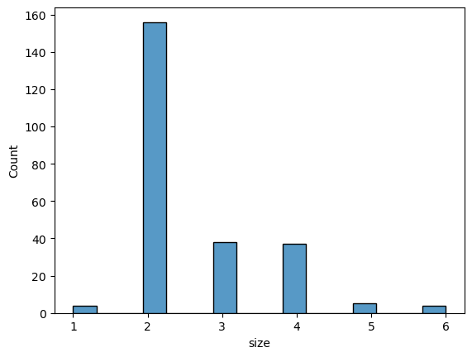
Most of the People come with size 2.

Slide 14
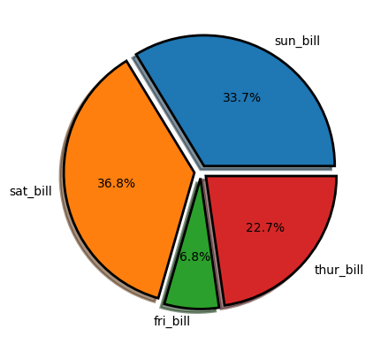
Maximum Percentage of bill pay on Sunday.

Slide 15
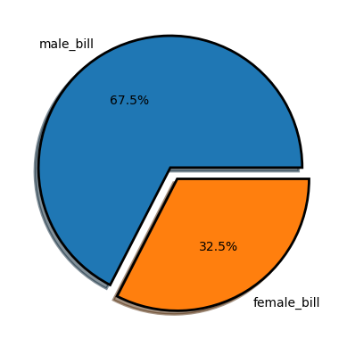
Maximum Percentage of bill pay by Males.

Slide 16
Thank You

